Slide 1

Rental Listings in US Major Metros
UT Bootcamp Project 3

Slide 2
Contents
Data Sources, ETL, EDA
Foundation of the Flask App + Website
Section 3
Section 4
Section 5

Slide 3
Data Sources
US Rental Listings (as of January 2020)
Source: https://www.kaggle.com/datasets/austinreese/usa-housing-listings
Filtered down to focus on 12 largest metros (according to: https://worldpopulationreview.com/us-cities)
US News Rankings of Best Cities (as of December 2019)
Source: https://www.kaggle.com/datasets/pileatedperch/best-cities-for-data-scientists ('metro_areas' csv)
Census Data for Average Income by City (as of 2021)
Source: https://www.bea.gov/data/income-saving/personal-income-county-metro-and-other-areas ('Metropolitian Area Table’)
City Demographics (as of 2020 Census)
Source: https://worldpopulationreview.com/us-cities
This project presented several data challenges:
finding broad data that is more current than 2020
finding data at a matching valuation date of (~2020)
reducing listings data for ease of use and storage, and to isolate more apples-to-apples comparison among major cities

Slide 4
Data ETL
Data was downloaded in Excel/csv format and imported into Python
Data cleansing included:
Populating missing values
Filtering out potentially errant values (ie. ‘Price’ < 100, ‘Square Feet’ < 200, etc.)
Creating uniform categorization (ie. ‘Dallas’, ‘Forth Worth’ -> ‘DFW’, ‘San Francisco’, ‘San Jose’ -> ‘SF/SJ’)
Creating new variables: ‘Density’, ‘Population Growth’, ‘Listings per 1k Capita’, etc.
Established SQLite connection
Converted data to Pandas data frames
Individual Rental Listings
Summary metrics by city (merged from all sources)

Slide 5
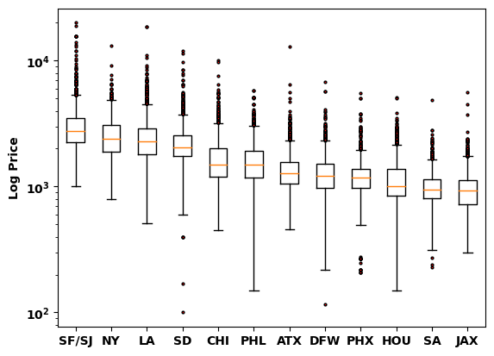
EDA - Price

Slide 6
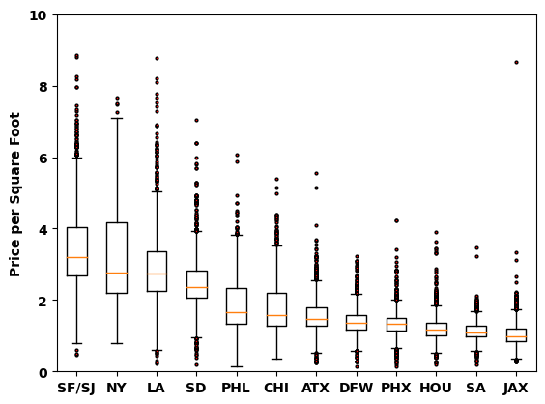
EDA – Price per Square Foot

Slide 7
EDA – Unit Features

Slide 8
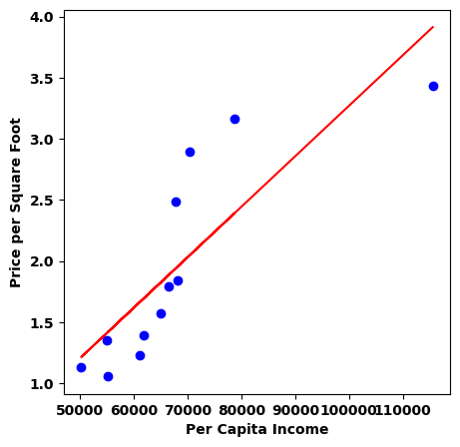
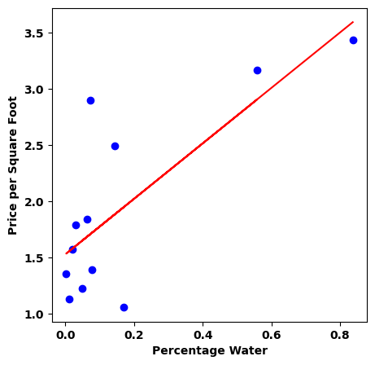
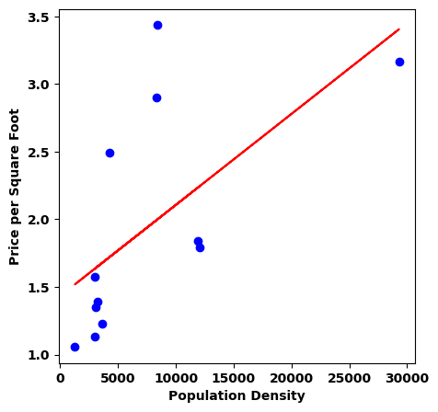
EDA – Positive Correlations with Price / SqFt

Slide 9
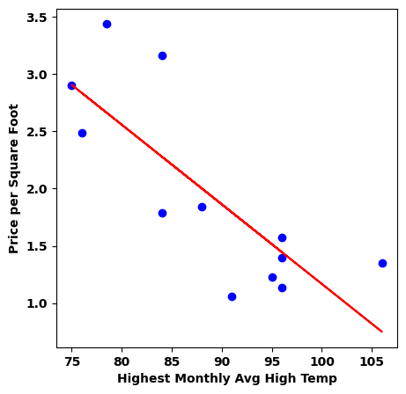
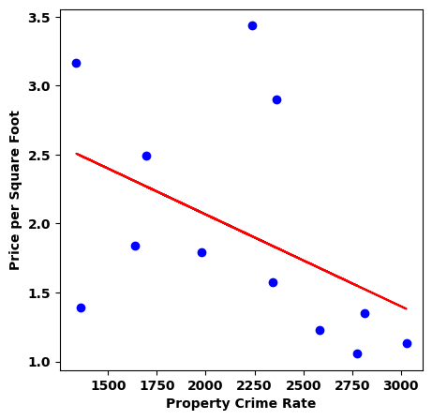
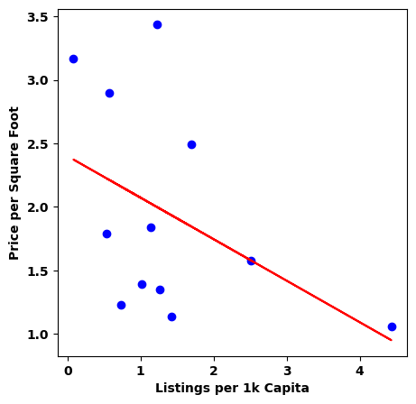
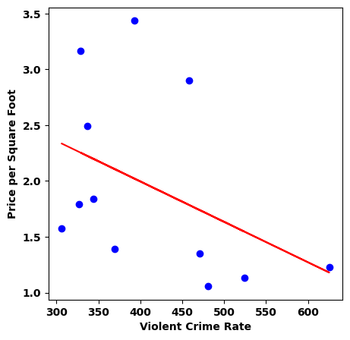
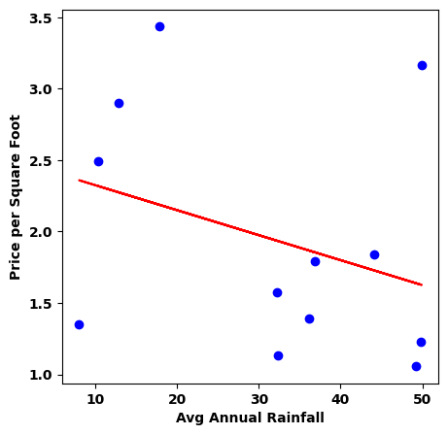
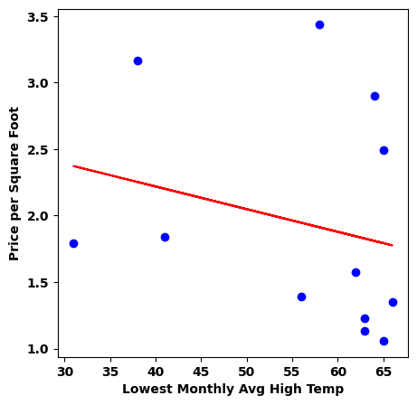
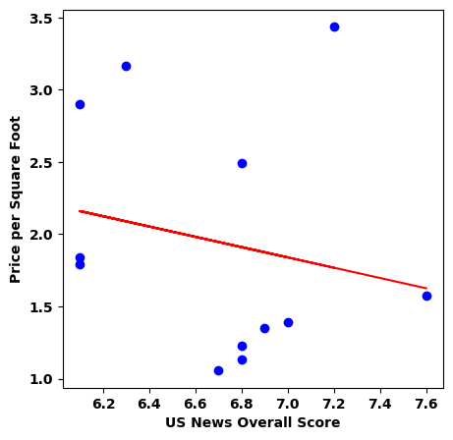
EDA – Negative Correlations with Price / SqFt

Slide 10
Flask App
A rudimentary Flask app was set up with three basic endpoints.
Index/Homepage directory
Search engine
Data Analysis presentation

Slide 11
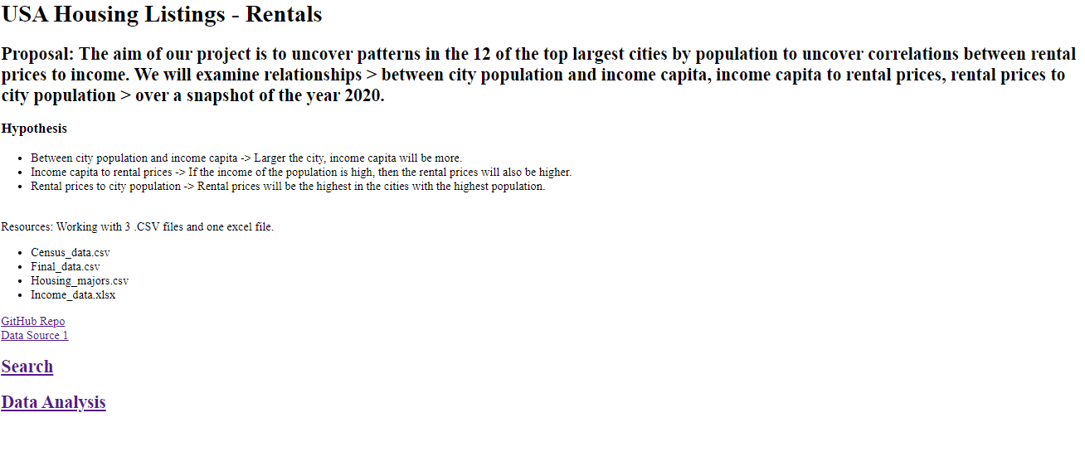
Index Page
Our index page presented our project proposal, hypotheses, resources, and links to the two feature-laden endpoints.

Slide 12
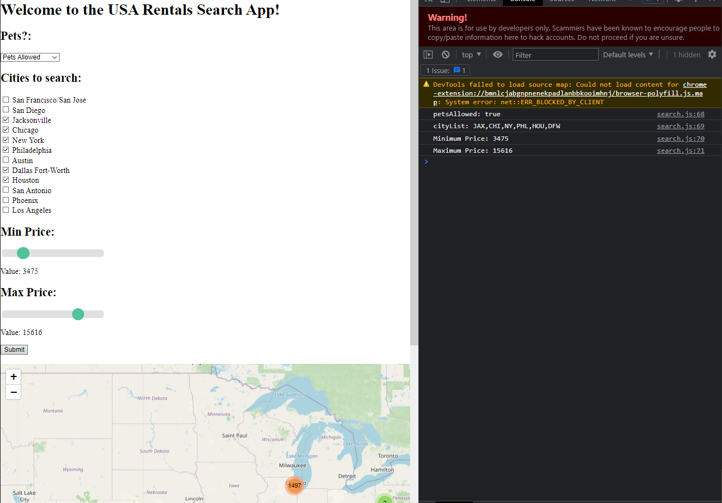
Search
The full search functionality is not yet completed. We currently lack the database query/database connection.
We do, however, correctly store the user’s selections as shown in the console log.

Slide 13
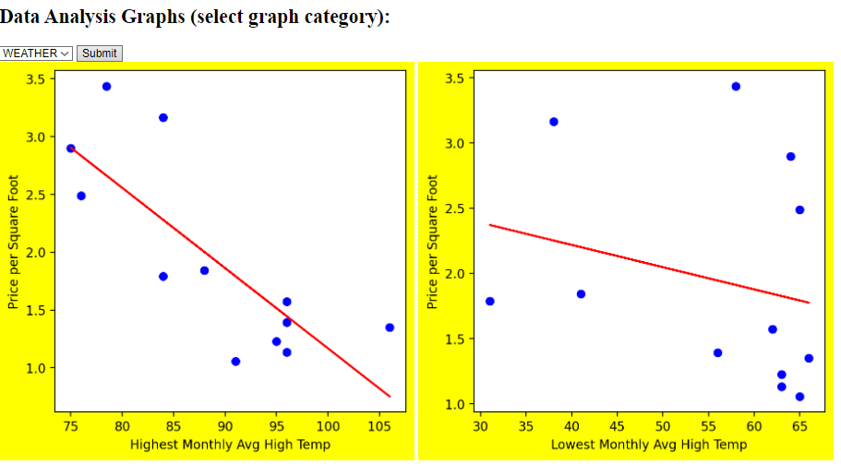
Data Analysis
At this endpoint, we allow the user to select (using a dropdown menu) a category of analysis graphs to display.

